Slide 1


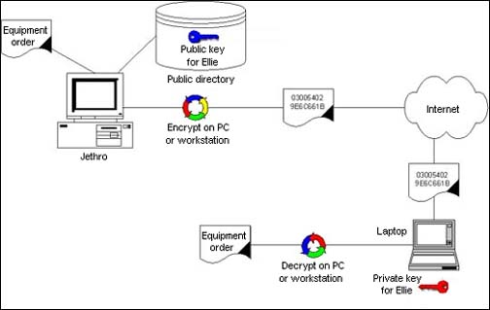
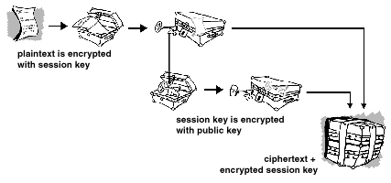





ELECTRONIC MAIL SECURITY
Overview
PGP (Pretty Good Privacy) is an open source freely available software package for E-mail security.
It is widely used scheme that doesn’t depend on any organization or authority, this makes PGP attractive.
PGP is now on an Internet standards track (RFC 3156)
It is based on algorithms like RSA, DSS, Diffie-Hellman for public key encryption; CAST-128, IDEA, and 3DES for Symmetric encryption; and SHA-1 for HASH coding.
S/MIME (Secure/Multipurpose Internet Mail Extension) is an internet standard approach to E-mail security.
A security enhancement to MIME & an industry standard for commercial and organizational use.
RFC 3369, 3370, 3850, 3851
Algorithm incorporates three public-key algorithms DSS, Diffie-Hellma for encrypting session keys, ElGamal provides encryption/decryption.
Actual Operations
Authentication through Digital Signatures
Confidentiality through Symmetric Block Encryption.
Compression through ZIP algorithm.
E-mail Compatibility through RADIX-64 Encoding Scheme
Segmentation & Reassembly for long E-mails.
Enveloped data: encrypted content & associated keys.
Signed data: encoded message + signed digest
Clear-signed data: clear text message + encoded signed digest.
Signed & Enveloped data: nesting of signed & encrypted entities.
Names: Rakhshanda, Hira Shaz, Asad, Nizam Instructor: Asima Nisar

